Slide 1
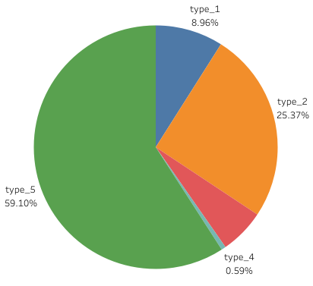
Google Fiber Executive Summary
Project
Overview
Google Fiber customer call center needs to understand how often customers phone customer support again after their first inquiry; this will help leaders understand whether the team is able to answer customer questions the first time. Further, leaders want to explore trends in repeat calls to identify why customers are having to call more than once, as well as how to improve the overall customer experience.
Project Goal
Explore trends in repeat callers to reduce call volume by increasing customer satisfaction and improving operational optimization.
Details
Repeat Calls by Type
Keys to success
Understand how often customers are calling customer support after their first inquiry.
Provide insights into the types of customer issues that seem to generate more repeat calls.
Explore repeat caller trends in the three different market cities.
Key Insights
The issue causing the most repeat calls in every market is type 5. It accounts for 6 out of every 10 repeat calls.
Reflections/
Next Steps
9 of 10 questions are answered on initial inquiry.
Problem types 2 and 5 account for 84% of repeat calls.
Further inquiry into why problem types 2 and 5 generate so many repeat calls.

